Slide 1



Slide 2
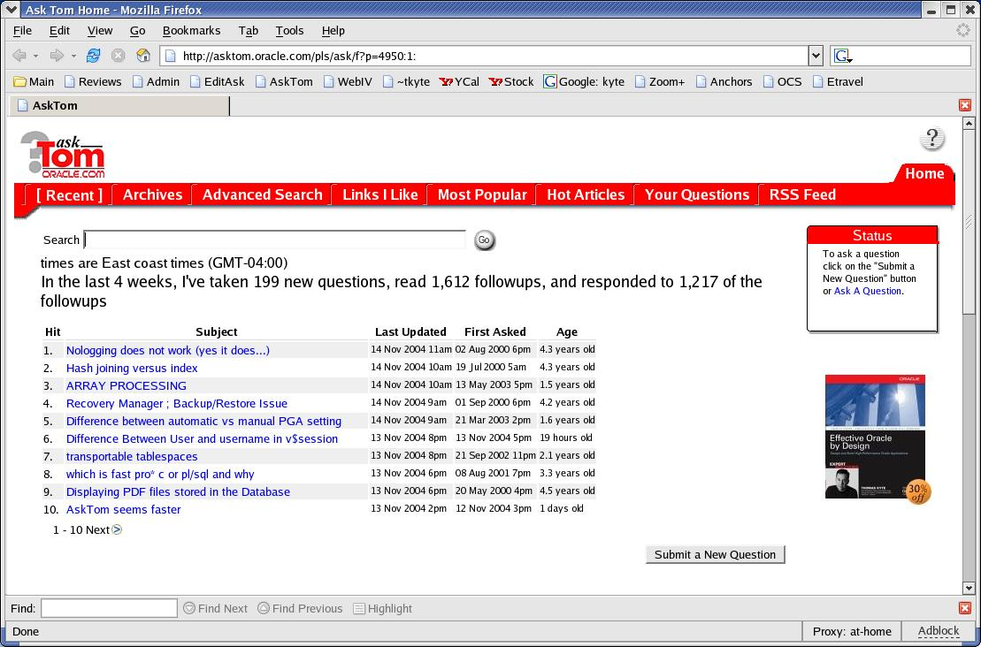



Who am I
Been with Oracle for over 11 years
User of Oracle for about 17 years
The “Tom” behind AskTom in Oracle Magazine
  www.oracle.com/oramag
Effective Oracle by Design
Expert One on One Oracle
Beginning Oracle

Slide 3
Top Ten Oracle 10g Things
Flashing Back
PLSQL is so much faster
HTMLDB
ASM
DBMS_ADVANCED_REWRITE
SQL Profiles
Online Redefine
Case Insensitive Searching
Fewer Invalidations
Online Segment Shrink

Slide 4
Online Segment Shrink
Table fills over time
You delete rows
Lots of whitespace
  You want to get it back
  You full scan and want it smaller
In the past
  Alter table move, Alter index rebuild
  Export/Import
  Offline
Not any more…
Demo shrink.sql

Slide 5
Top Ten Oracle 10g Things
Flashing Back
PLSQL is so much faster
HTMLDB
ASM
DBMS_ADVANCED_REWRITE
SQL Profiles
Online Redefine
Case Insensitive Searching
Fewer Invalidations
Online Segment Shrink

Slide 6
Less Invalidations
Change tables without
  Recompiling Stored Procedures
  Recompiling Views
Compiled stored objects can depend on the synonym
I used to use loopback database links and views, this is infinitely easier and faster

Slide 7
Less invalidations
SQL> create table t1 ( x int );
SQL> create table t2 ( x int, y int );
SQL> create synonym t for t1;
SQL> create or replace procedure p
2 as
3 begin
4 for x in (select * from t) loop null; end loop;
8 end;
9 /
SQL> create or replace view v
2 as
3 select x from t
4 /

Slide 8
Less invalidations
ORA9IR2> select status from user_objects
where object_name in( ‘P’, ‘V’ );
STATUS
-------
VALID
VALID
ORA9IR2> create or replace synonym t for t2;
Synonym created.
ORA9IR2> select status from user_objects
where object_name in( ‘P’, ‘V’ );
STATUS
-------
INVALID
INVALID

Slide 9
Less invalidations
ORA10G> select status from user_objects
where object_name in( ‘P’, ‘V’ );
STATUS
-------
VALID
VALID
ORA10G> create or replace synonym t for t2;
Synonym created.
ORA10G> select status from user_objects
where object_name in( ‘P’, ‘V’ );
STATUS
-------
VALID
VALID

Slide 10
Top Ten Oracle 10g Things
Flashing Back
PLSQL is so much faster
HTMLDB
ASM
DBMS_ADVANCED_REWRITE
SQL Profiles
Online Redefine
Case Insensitive Searching
Fewer Invalidations
Online Segment Shrink

Slide 11
Case insensitive…
Sorts
Compares
100% transparent to applications
Can still use indexes
ci.sql

Slide 12
Top Ten Oracle 10g Things
Flashing Back
PLSQL is so much faster
HTMLDB
ASM
DBMS_ADVANCED_REWRITE
SQL Profiles
Online Redefine
Case Insensitive Searching
Fewer Invalidations
Online Segment Shrink

Slide 13
Online Redfine
Enhanced Online Table Redefinition
  Easy cloning of indexes, grants, constraints, etc.
    Down to 4 easy steps
      Create new, empty table
      Start redef (initial copy)
      Copy_Table_Dependents, instead of manually indexing, altering, etc
      Finish redef
  Convert from long to LOB online
Redef.sql

Slide 14
Top Ten Oracle 10g Things
Flashing Back
PLSQL is so much faster
HTMLDB
ASM
DBMS_ADVANCED_REWRITE
SQL Profiles
Online Redefine
Case Insensitive Searching
Fewer Invalidations
Online Segment Shrink

Slide 15
SQL Profiles
Tune SQL without tuning SQL
Looks at ‘how the query is used’
  First rows vs All rows for example
Based on execution history
Will also store additional statistics relating to cross object relationships
For example….

Slide 16
SQL Profiles
ops$tkyte@ORA10G> create or replace procedure p
2 as
3 cursor c1
4 is
5 select object_id, object_name
6 from sqlprof
7 order by object_id;
9 l_object_id sqlprof.object_id%type;
10 l_object_name sqlprof.object_name%type;
11 begin
12 open c1;
13 for i in 1 .. 10
14 loop
15 fetch c1 into l_object_id, l_object_name;
16 exit when c1%notfound;
17 -- ....
18 end loop;
19 end;
20 /
Procedure created.

Slide 17
SQL Profiles
SELECT OBJECT_ID, OBJECT_NAME FROM SQLPROF ORDER BY OBJECT_ID
call count cpu elapsed query current rows
------- ------ -------- ---------- ---------- ---------- ----------
Parse 1 0.00 0.00 0 0 0
Execute 1 0.00 0.00 0 0 0
Fetch 10 0.07 0.10 659 0 10
------- ------ -------- ---------- ---------- ---------- ----------
total 12 0.07 0.10 659 0 10
Misses in library cache during parse: 1
Optimizer mode: ALL_ROWS
Parsing user id: 410 (recursive depth: 1)
Rows Row Source Operation
------- ---------------------------------------------------
10 SORT ORDER BY (cr=659 pr=0 pw=0 time=101152 us)
47487 TABLE ACCESS FULL SQLPROF (cr=659 pr=0 pw=0 time=47604 us)

Slide 18
SQL Profiles
ops$tkyte@ORA10G> declare
2 l_sql_id v$sql.sql_id%type;
3 begin
4 select sql_id into l_sql_id
5 from v$sql
6 where sql_text = 'SELECT OBJECT_ID, OBJECT_NAME
FROM SQLPROF ORDER BY OBJECT_ID';
7 dbms_output.put_line(
8 sys.dbms_sqltune.create_tuning_task
9 ( sql_id => l_sql_id,
10 task_name => 'sqlprof_query' ) || ' in place...' );
11 dbms_sqltune.execute_tuning_task
12 ( task_name => 'sqlprof_query' );
13 end;
14 /
PL/SQL procedure successfully completed.

Slide 19
SQL Profiles
ops$tkyte@ORA10G> SELECT DBMS_SQLTUNE.REPORT_TUNING_TASK( 'sqlprof_query')
2 FROM DUAL;
DBMS_SQLTUNE.REPORT_TUNING_TASK('SQLPROF_QUERY')
--------------------------------------------------------------------------------
GENERAL INFORMATION SECTION
…
-------------------------------------------------------------------------------
SQL ID : 3zfpa86satsm3
SQL Text: SELECT OBJECT_ID, OBJECT_NAME FROM SQLPROF ORDER BY OBJECT_ID
-------------------------------------------------------------------------------
FINDINGS SECTION (1 finding)
-------------------------------------------------------------------------------
1- SQL Profile Finding (see explain plans section below)
--------------------------------------------------------
A potentially better execution plan was found for this statement.
Recommendation (estimated benefit: 99.45%)
------------------------------------------
Consider accepting the recommended SQL profile.
execute :profile_name := dbms_sqltune.accept_sql_profile(task_name =>
'sqlprof_query')

Slide 20
SQL Profiles
-------------------------------------------------------------------------------
EXPLAIN PLANS SECTION
-------------------------------------------------------------------------------
1- Original With Adjusted Cost
------------------------------
Plan hash value: 1044598349
--------------------------------------------------------------------------------------
| Id | Operation | Name | Rows | Bytes |TempSpc| Cost (%CPU)| Time|
--------------------------------------------------------------------------------------
| 0 | SELECT STATEMENT | | 47487 | 1391K| | 546 (3)| 00:00:07 |
| 1 | SORT ORDER BY | | 47487 | 1391K| 3736K| 546 (3)| 00:00:07 |
| 2 | TABLE ACCESS FULL| SQLPROF | 47487 | 1391K| | 151 (2)| 00:00:02 |
--------------------------------------------------------------------------------------
2- Using SQL Profile
--------------------
Plan hash value: 337606071
------------------------------------------------------------------------------------------ | Id | Operation | Name | Rows | Bytes | Cost (%CPU)|Time | ------------------------------------------------------------------------------------------
| 0 | SELECT STATEMENT | | 10 | 300 | 3 (0)|00:00:01 |
| 1 | TABLE ACCESS BY INDEX ROWID| SQLPROF | 47487 | 1391K| 3 (0)|00:00:01 |
| 2 | INDEX FULL SCAN | SQLPROF_PK | 10 | | 2 (0)|00:00:01 |
------------------------------------------------------------------------------------------

Slide 21
Top Ten Oracle 10g Things
Flashing Back
PLSQL is so much faster
HTMLDB
ASM
DBMS_ADVANCED_REWRITE
SQL Profiles
Online Redefine
Case Insensitive Searching
Fewer Invalidations
Online Segment Shrink

Slide 22
DBMS_ADVANCED_REWRITE
Fix that unfixable SQL statement
  For correctness
  For performance
When you cannot otherwise touch it
rewrite.sql

Slide 23
Top Ten Oracle 10g Things
Flashing Back
PLSQL is so much faster
HTMLDB
ASM
DBMS_ADVANCED_REWRITE
SQL Profiles
Online Redefine
Case Insensitive Searching
Fewer Invalidations
Online Segment Shrink

Slide 24
ASM – Automatic Storage Management
Database file system
  Striping
  Mirroring
  Rebalancing
No more moving files from point A to point B – ever
Fundamentally changes the way you look at storage
It’s a performance thing
It’s a manageability thing
It’s an availability thing

Slide 25



ASM – Automatic Storage Management
Choices for disk group redundancy
  External: defers to hardware mirroring
  Normal: 2-way mirroring
  High: 3-way mirroring

Slide 26

ASM – Automatic Storage Management
Mirror at extent level
Mix primary & mirror extents on each disk

Slide 27

ASM – Automatic Storage Management
Mirror at extent level
Mix primary & mirror extents on each disk

Slide 28
ASM – Automatic Storage Management
No hot spare disk required
  Just spare capacity
  Failed disk load spread among survivors
  Maintains balanced I/O load

Slide 29


ASM – Automatic Storage Management
Migration from existing stora new storage can be done by ASM with less complexity and no downtime
Disk Group
Disk Group

Slide 30
Top Ten Oracle 10g Things
Flashing Back
PLSQL is so much faster
HTMLDB
ASM
DBMS_ADVANCED_REWRITE
SQL Profiles
Online Redefine
Case Insensitive Searching
Fewer Invalidations
Online Segment Shrink

Slide 31
Top Ten Oracle 10g Things
Flashing Back
PLSQL is so much faster
HTMLDB
ASM
DBMS_ADVANCED_REWRITE
SQL Profiles
Online Redefine
Case Insensitive Searching
Fewer Invalidations
Online Segment Shrink

Slide 32
PL/SQL Performance
Out of the box – no changes, it is faster
It’s all about PL/SQL.
  Optimizing compiler
  Bad_code.sql
Implicit Array Fetching
  Af.sql

Slide 33
PL/SQL Performance
Native Floats
  IEEE floating point support in SQL and PLSQL
  π / 4 = 1 - 1/3 + 1/5 - 1/7 + 1/9…
  Pi_9i.sql
  Pi_10g.sql
  Bindbl.sql
Predicable fixed width datatype
Scientific applications will truly appreciate this
But remember – numbers are very “accurate”, floats/doubles “not as accurate”
But also remember – 11 bit exponent gives larger range of values

Slide 34
Top Ten Oracle 10g Things
Flashing Back
PLSQL is so much faster
HTMLDB
ASM
DBMS_ADVANCED_REWRITE
SQL Profiles
Online Redefine
Case Insensitive Searching
Fewer Invalidations
Online Segment Shrink

Slide 35
Flashback
Flashback Query
  9iR1 – primitive
    Had to open flashback cursors before doing any DML
    It worked, but was not “easy”
  9iR2 – sophisticated
    No need to open cursors before doing modifications
    Can flashback in SQL, no packages needed
    Can flashback in modifications
    It worked and was much easier
      Could join the table with itself as of N minutes ago
      Put update a set of rows, put them back as they were N minutes ago

Slide 36
Flashback
In 10g
  Flashback Query
  Flashback Table
  Flashback Row History
  Flashback Drop
  Flashback Database

Slide 37
Flashback – Flashback Row History
Instead of “show me the data as of”, you can say “show me all versions of the data between”
Select ename, sal
from emp versions between timestamp a and b
where ename = ‘SCOTT’
ENAME SAL
---------- ----------
SCOTT 3000
SCOTT 3300
SCOTT 3630
…

Slide 38
Flashback – Flashback Row History
See related information about each row
  SCN range the row was “valid for”
  Time range (approx) the row was valid for
  The transaction id (XID) that modified the row
  The operation (I/U/D) that was performed on the row
select ename, sal,
versions_operation,
versions_starttime,
versions_endtime,
versions_startscn,
versions_endscn,
versions_xid
from emp versions between timestamp &A and &B
where empno = 7788
order by versions_startscn nulls first
Fb7.sql

Slide 39
Flashback – Flashback Drop Table
Uses a recycle bin metaphor
  Table/indexes/triggers/constraints are renamed
  Extents are not deallocated immediately
  Whether you can undrop something depends entirely on how “full” your tablespace was!
  This is useful for “whoops” recovery right after the fact
  You may be able to undrop a table months after the fact
  You may not be able to undrop a table seconds after the fact!
Fb10.sql

Slide 40
Flashback – Flashback Table
Multiple table T’s may exist in the recycle bin
  HTML/DB demo story
You should rename indexes et.al. after the fact
RI (foreign keys from child tables) are not “undropped”
  You had to specify “cascade constraints”
  The fkeys are not really part of “this table” anyway

Slide 41
Flashback Database
A new strategy for point in time recovery
Flashback Log captures old versions of changed blocks
  Think of it as a continuous backup
  Replay log to restore DB to time
  Restores just changed blocks
It’s fast - recover in minutes, not hours
It’s easy - single command restore
  SQL> Flashback Database to ‘2:05 PM’
Disk Write
New Block
Version
Old Block
Version
Data
Files
Flashback Log
“Rewind” button for the Database
Holds old block contents

Slide 42
Questions
and
Answers

